Slide 1
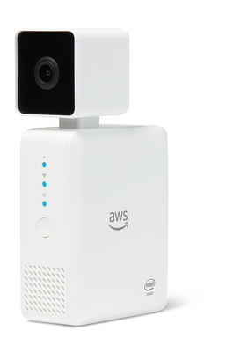
AWS DeepLens:
A New Way to Learn Machine Learning
Margaret Valtierra
Chicago AWS user group
@margaretvaltie

Slide 2

Now, let’s see it in action….
@margaretvaltie
Notes:
This is where you show a live demo of face detection, ideally running the sentiment analysis as shown in the DEAR demo video

Slide 3
@margaretvaltie
Notes:
Talk about AI >> Machine Learning >> Deep Learning
First, let’s just give you the TL;DR on the terminology:
- AI: Artificial Intelligence, the term used to describe when you imbue machines with ‘smarts’, and specifically doing that using learning algorithms.
Machine Learning and Deep Learning are subsets of AI
With ML, an algorithm for predictions is based upon fitting a function to the sample data.
With DL, the algorithm doesn’t need specific instructions to make predictions, but can find patterns in data and use those patterns to make predictions. The basis for DL is using a neural network inspired by the understanding of our brains. The artificial neural networks are composed of neurons, but have discrete layers, connections, and directions of data propagation. Just like human brains, these networks need to be trained with vast amounts of data… which leads us to the next slide….

Slide 4
Slightly outdated AWS ML service stack
* Textract * Personalize * Forecast
* Amazon SageMaker Ground Truth * Amazon SageMaker Neo
* TensorFlow on AWS
@margaretvaltie

Slide 5
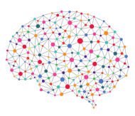
1. MACHINE LEARNING OVERVIEW
@margaretvaltie
Notes:
Talk about AI >> Machine Learning >> Deep Learning
First, let’s just give you the TL;DR on the terminology:
- AI: Artificial Intelligence, the term used to describe when you imbue machines with ‘smarts’, and specifically doing that using learning algorithms.
Machine Learning and Deep Learning are subsets of AI
With ML, an algorithm for predictions is based upon fitting a function to the sample data.
With DL, the algorithm doesn’t need specific instructions to make predictions, but can find patterns in data and use those patterns to make predictions. The basis for DL is using a neural network inspired by the understanding of our brains. The artificial neural networks are composed of neurons, but have discrete layers, connections, and directions of data propagation. Just like human brains, these networks need to be trained with vast amounts of data… which leads us to the next slide….

Slide 6

5 second history of deep learning
Artificial Intelligence (AI)
Machine Learning (ML)
Deep Learning
@margaretvaltie
Notes:
Talk about AI >> Machine Learning >> Deep Learning
First, let’s just give you the TL;DR on the terminology:
- AI: Artificial Intelligence, the term used to describe when you imbue machines with ‘smarts’, and specifically doing that using learning algorithms.
Machine Learning and Deep Learning are subsets of AI
With ML, an algorithm for predictions is based upon fitting a function to the sample data.
With DL, the algorithm doesn’t need specific instructions to make predictions, but can find patterns in data and use those patterns to make predictions. The basis for DL is using a neural network inspired by the understanding of our brains. The artificial neural networks are composed of neurons, but have discrete layers, connections, and directions of data propagation. Just like human brains, these networks need to be trained with vast amounts of data… which leads us to the next slide….

Slide 7
5 second history of deep learning
Artificial Intelligence (AI)
Machine Learning = algorithm
Deep Learning uses patterns to make predictions
Machine Learning (ML)
Deep Learning
Neural networks trained with big data sets
@margaretvaltie
Notes:
Talk about AI >> Machine Learning >> Deep Learning
First, let’s just give you the TL;DR on the terminology:
- AI: Artificial Intelligence, the term used to describe when you imbue machines with ‘smarts’, and specifically doing that using learning algorithms.
Machine Learning and Deep Learning are subsets of AI
With ML, an algorithm for predictions is based upon fitting a function to the sample data.
With DL, the algorithm doesn’t need specific instructions to make predictions, but can find patterns in data and use those patterns to make predictions. The basis for DL is using a neural network inspired by the understanding of our brains. The artificial neural networks are composed of neurons, but have discrete layers, connections, and directions of data propagation. Just like human brains, these networks need to be trained with vast amounts of data… which leads us to the next slide….

Slide 8
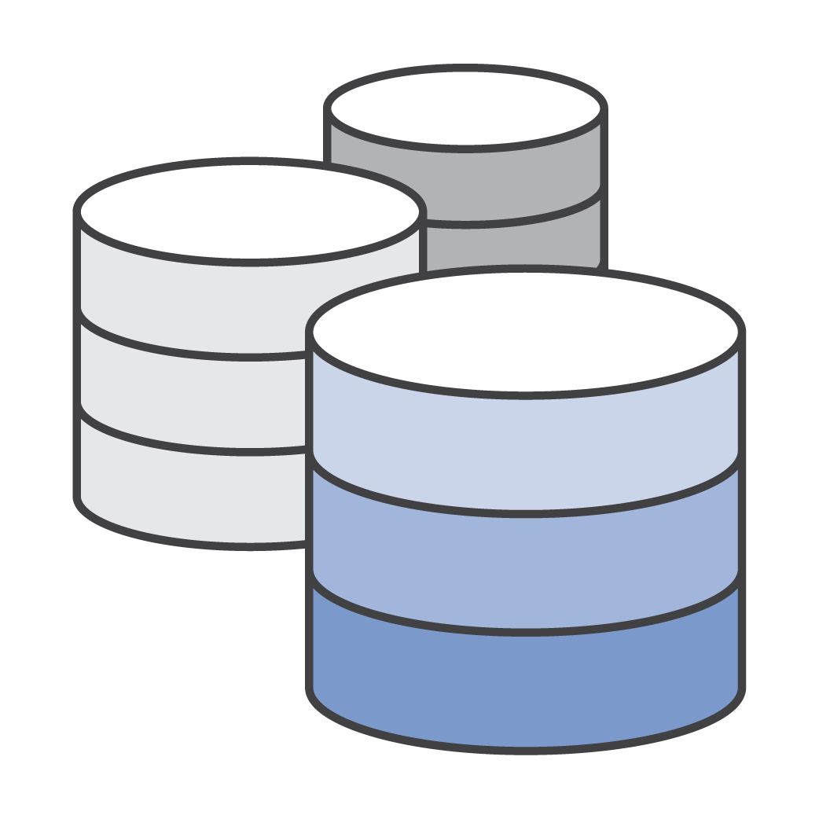


OVERVIEW OF DEEP LEARNING
Data
Model training
Inference
@margaretvaltie
Notes:
Deep Learning in the simplest terms, when applied to solving a problem, can be broken down into three components.
First, as we mentioned in the overview slide, Deep Learning is predicated on the existence of data – lots and lots of data.
Second, there is a Model, which at the highest level is the system that makes predictions or identifications, and can be ‘trained’
Third, there is the action portion of Deep Learning, where the ‘trained model’ is used to make a prediction or identification based on new data

Slide 9

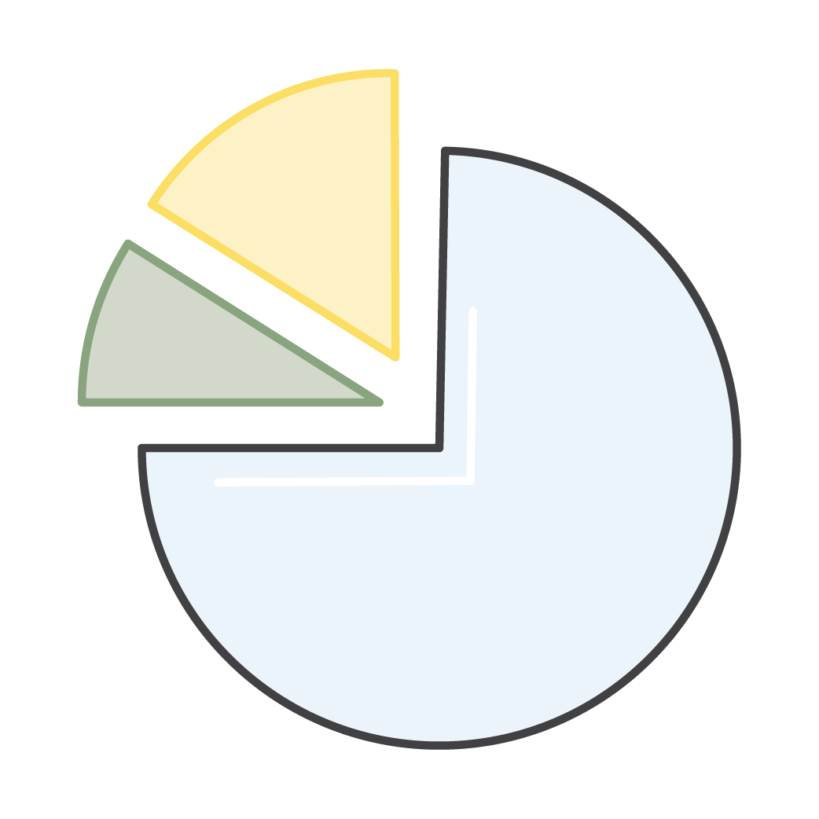


DATA
Annotate
Preprocess
Data split
@margaretvaltie
Notes:
So let’s talk about Data. For effective Deep Learning, large amounts of data are required to train your neural net.
Annotation is required for training called ‘supervised learning’ - basically teaching your model about specific classifications or identification. E.g. this picture is of a dog. There is a face at this location in this picture.
Pre-processing allows a consistent understanding of the input data. Same size, format, etc.
Split – when training your data, you want to ’hold back’ a set of data to ensure that you can ‘test’ the predictions and you can tune the parameters of the neural net.

Slide 10
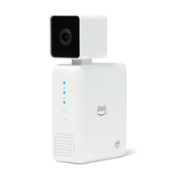
2. DEEPLENS OVERVIEW
@margaretvaltie

Slide 11
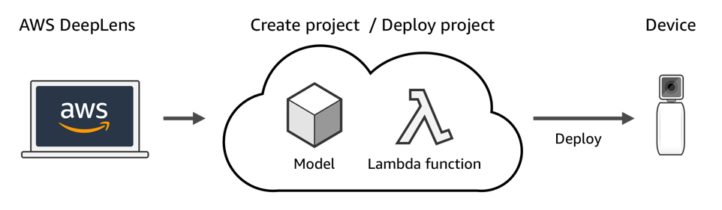
Build -> Deploy -> Predict
@margaretvaltie

Slide 12
@margaretvaltie

Slide 13
@margaretvaltie

Slide 14
@margaretvaltie

Slide 15
@margaretvaltie

Slide 16
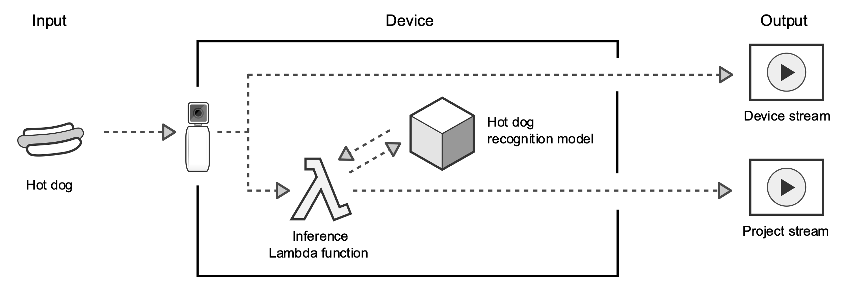
Predicting IRL with DeepLens
@margaretvaltie

Slide 17
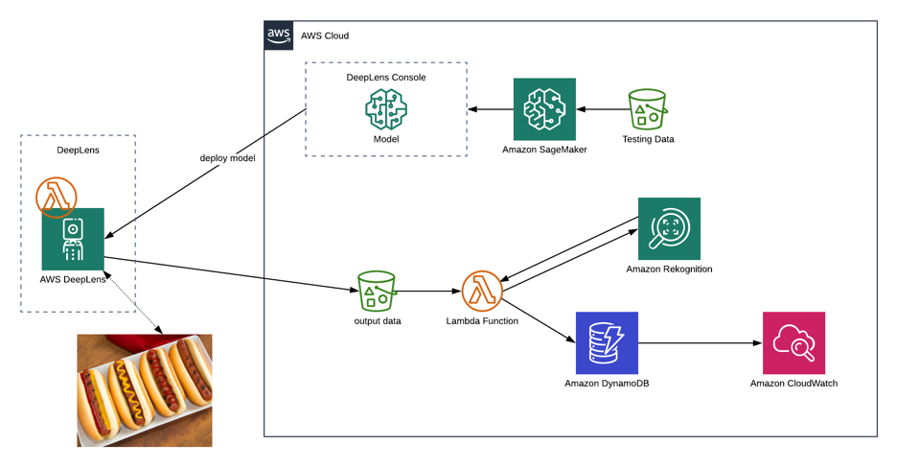
Journey through a DeepLens
@margaretvaltie
Notes:
Talk about AI >> Machine Learning >> Deep Learning
First, let’s just give you the TL;DR on the terminology:
- AI: Artificial Intelligence, the term used to describe when you imbue machines with ‘smarts’, and specifically doing that using learning algorithms.
Machine Learning and Deep Learning are subsets of AI
With ML, an algorithm for predictions is based upon fitting a function to the sample data.
With DL, the algorithm doesn’t need specific instructions to make predictions, but can find patterns in data and use those patterns to make predictions. The basis for DL is using a neural network inspired by the understanding of our brains. The artificial neural networks are composed of neurons, but have discrete layers, connections, and directions of data propagation. Just like human brains, these networks need to be trained with vast amounts of data… which leads us to the next slide….

Slide 18
@margaretvaltie
Notes:
Talk about AI >> Machine Learning >> Deep Learning
First, let’s just give you the TL;DR on the terminology:
- AI: Artificial Intelligence, the term used to describe when you imbue machines with ‘smarts’, and specifically doing that using learning algorithms.
Machine Learning and Deep Learning are subsets of AI
With ML, an algorithm for predictions is based upon fitting a function to the sample data.
With DL, the algorithm doesn’t need specific instructions to make predictions, but can find patterns in data and use those patterns to make predictions. The basis for DL is using a neural network inspired by the understanding of our brains. The artificial neural networks are composed of neurons, but have discrete layers, connections, and directions of data propagation. Just like human brains, these networks need to be trained with vast amounts of data… which leads us to the next slide….

Slide 19
@margaretvaltie
IoT Gateway

Slide 20
Chicago DeepLens Projects

Slide 21
Questions?
DeepLens Library
@margaretvaltie

Slide 22
Resources

Slide 23
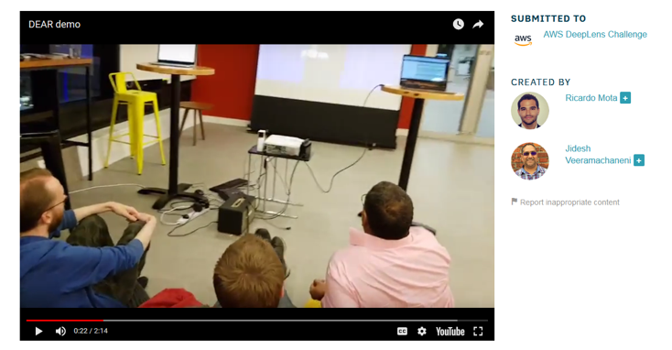
Watch the demo:
https://youtu.be/2oMGkWc46Lw

Slide 25


DEEPLENS SPECIFICATIONS
Intel Atom Processor
Gen9 graphics
Ubuntu OS- 16.04 LTS
100 GFLOPS performance
Dual band Wi-Fi
8 GB RAM
16 GB Storage (eMMC)
32 GB SD card
4 MP camera with MJPEG
H.264 encoding at 1080p resolution
2 USB ports
Micro HDMI
Audio out
AWS Greengrass preconfigured
clDNN Optimized for MXNet
@margaretvaltie

